Slide 1

Web Listening
Project
(Final Presentation)
By: Cheung Kai Chun Ronald,
Hazel Phua Yixuan

Slide 2
Table of Contents
01
02
03
Project Overview
Project
Flow
Progression
Timeline
04
05
Demo
Reflection

Slide 3

Project Overview
What is Web Listening?
Social listening refers to the tracking of social media platforms for mentions and conversations related to your brand, then analyzing them for insights to discover opportunities to act.
Goal: Develop an automated solution to collect, analyze and visualize social media discussions about specified keywords
Purpose: Help companies analyze their own brand along with their competitors

Slide 4
Project Flow
Develop a simple GUI for end users
Develop an automated web scraping solution to fetch real-time data from selected social media websites
Preprocess the data to prepare for analysis
Perform advanced analytics on the data, using Natural Language Processing (NLP) techniques, to gather insights and generate additional features from the data
Using a data visualization software, present the final dataset as a collection of meaningful and descriptive visualizations, to the end-user

Slide 5
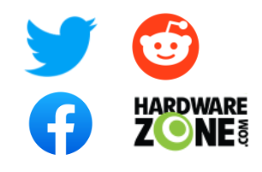
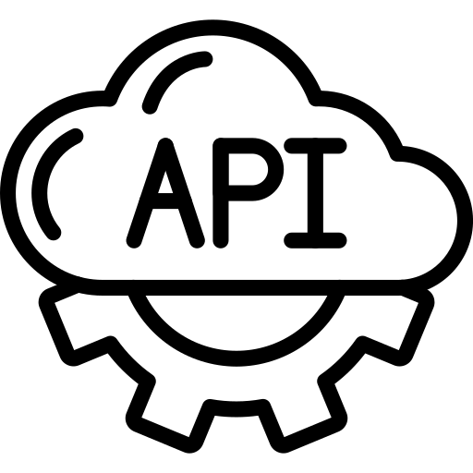






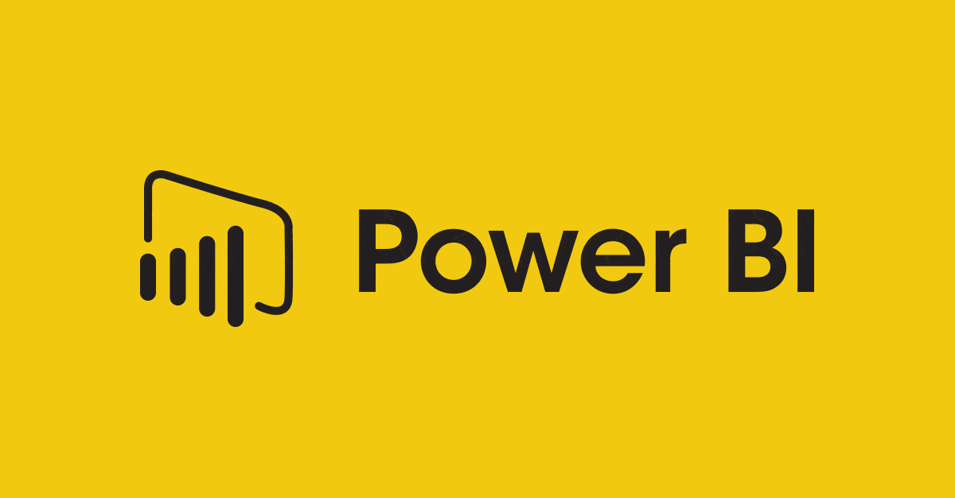
Project Flow
Data Analysis with NLP
Data Retrieval
Preprocess
from
Dataset
Sentiment
Topics
Modelling
Input
Dataset
User Interface
Dashboard

Slide 6




Week 1 to Week 4
Explored on several ways to scrape data off the web
Automate browser (Python Selenium)
Official/Open source APIs
Web scraping softwares
Settled on using APIs whenever available for ease of implementation
Collected data from following social media websites:
Twitter (using API)
Reddit (using API)
Facebook (using API)
HardwareZone (automate browser using python)
Notes:
Twitter,Reddit,Facebook because of popularity, will be able to gain a lot of relevant data from them
HardwareZone for local based data that is also quite relevant

Slide 7
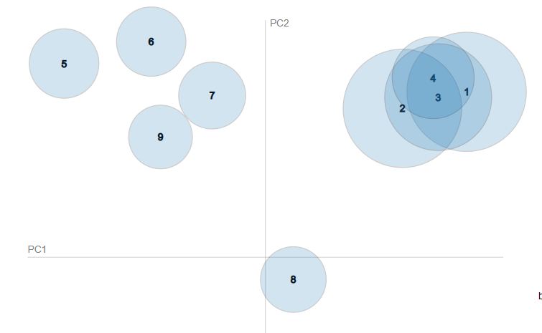
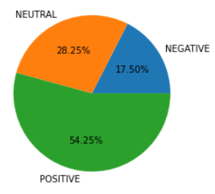
Week 5 to Week 6
Merged dataset collected from each social media into one large dataset
Research and implement data preprocessing techniques
Researched on a few NLP techniques and attempted implementation
Topic Modelling to find popular topics within dataset
Sentiment Analysis to identify overall sentiment of text
Attempted using current dataset to generate a few visualisations in PowerBI

Slide 8
Week 6 to Week 12
Continued on the analysis to determine which NLP model to use
Integrated all web scraping and analysis codes
Developed UI using Python GUI module
Improved data visualisation dashboard to visualize in more detail:
Each platform
Comparison
Sentiment
Topics
Integrated UI with the rest of the codes and Power BI
Testing

Slide 9
Demo
Notes:
Keywords used for this demo: Adidas & Nike

Slide 10

Reflection
What have we learnt?
Web Scraping techniques
Analysis and NLP techniques
Simple GUI creation in Python
Using Power BI to generate meaningful visualisations and analyse trends
Work with different charts to provide trend insights

Slide 11
Thanks!
Any Questions?
Please keep this slide for attribution

